Slide 1
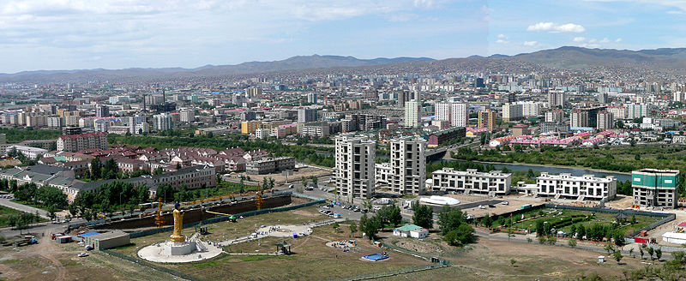
Natalia Kosheleva¹⁾,
Olga Sorokina¹⁾,
Dechingungaa Dorjgotov²⁾
HOT SPOT ASSESSMENT
IN THE SELENGA RIVER BASIN
1) Lomonosov Moscow State University, Faculty of Geography
2) Institute of Geography of Mongolian Academy of Science

Slide 2
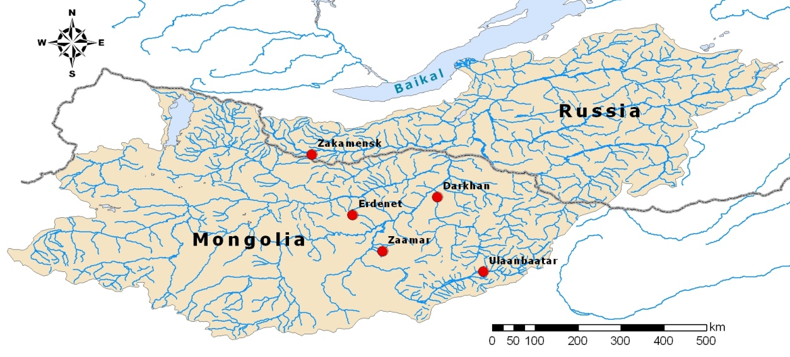
THE PURPOSES
to assess the levels of environment contamination of major industrial centers in the Selenga River basin with heavy metals and metalloids (HMs),
to define the size of technogenic geochemical anomalies of pollutants in various media, and
to determine the environmental hazard of the contamination.
The subjects of the study include:
large multi-industrial cities (Ulaanbaatar and Darkhan),
the Zaamar area on the Tuul River, which is the major center of gold mining in the basin and
mining cities with extraction and enrichment of non-ferrous metals (Erdenet and Zakamensk).

Slide 3
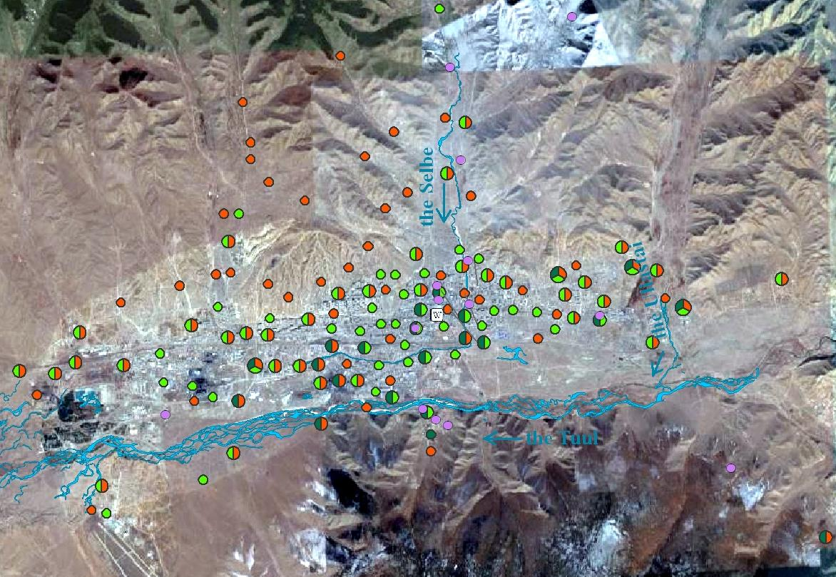

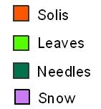

Location of Sampling Sites
Ulaanbaatar

Slide 4
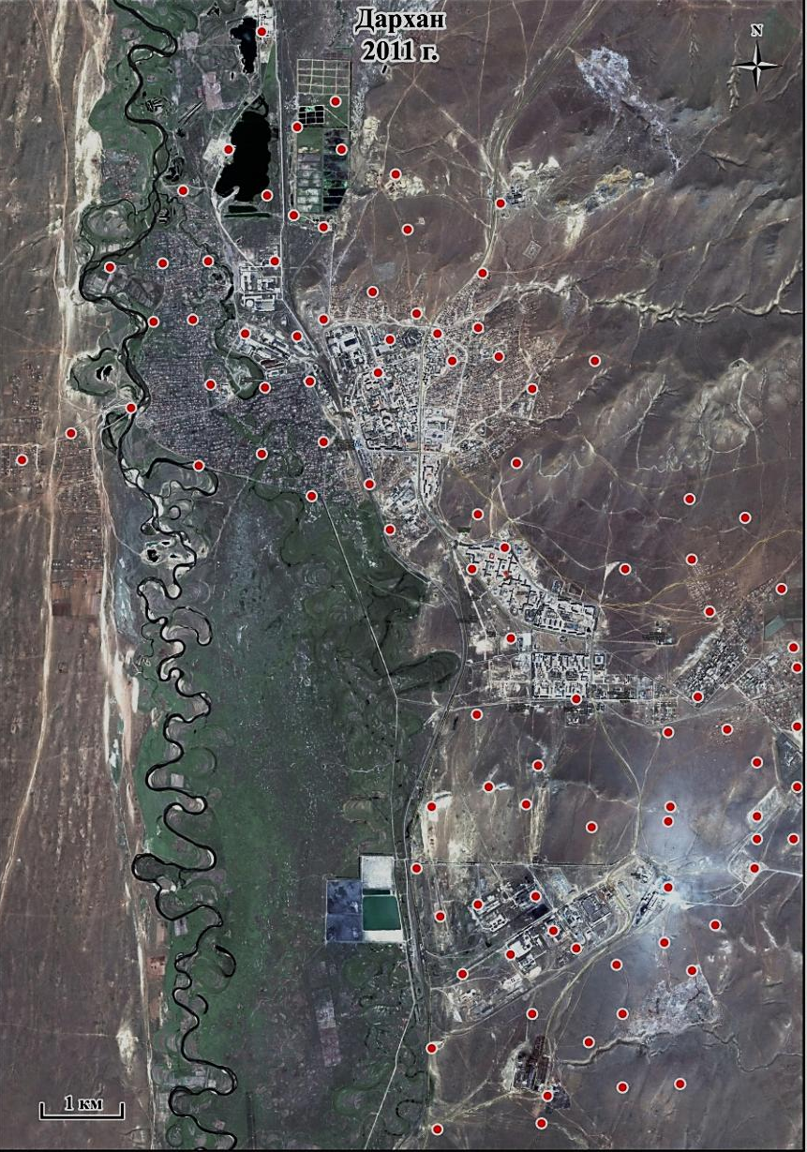
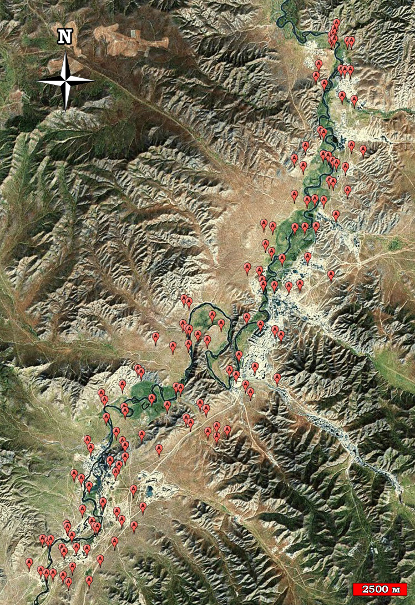
Location of Sampling Sites
Darkhan
Zaamar

Slide 5
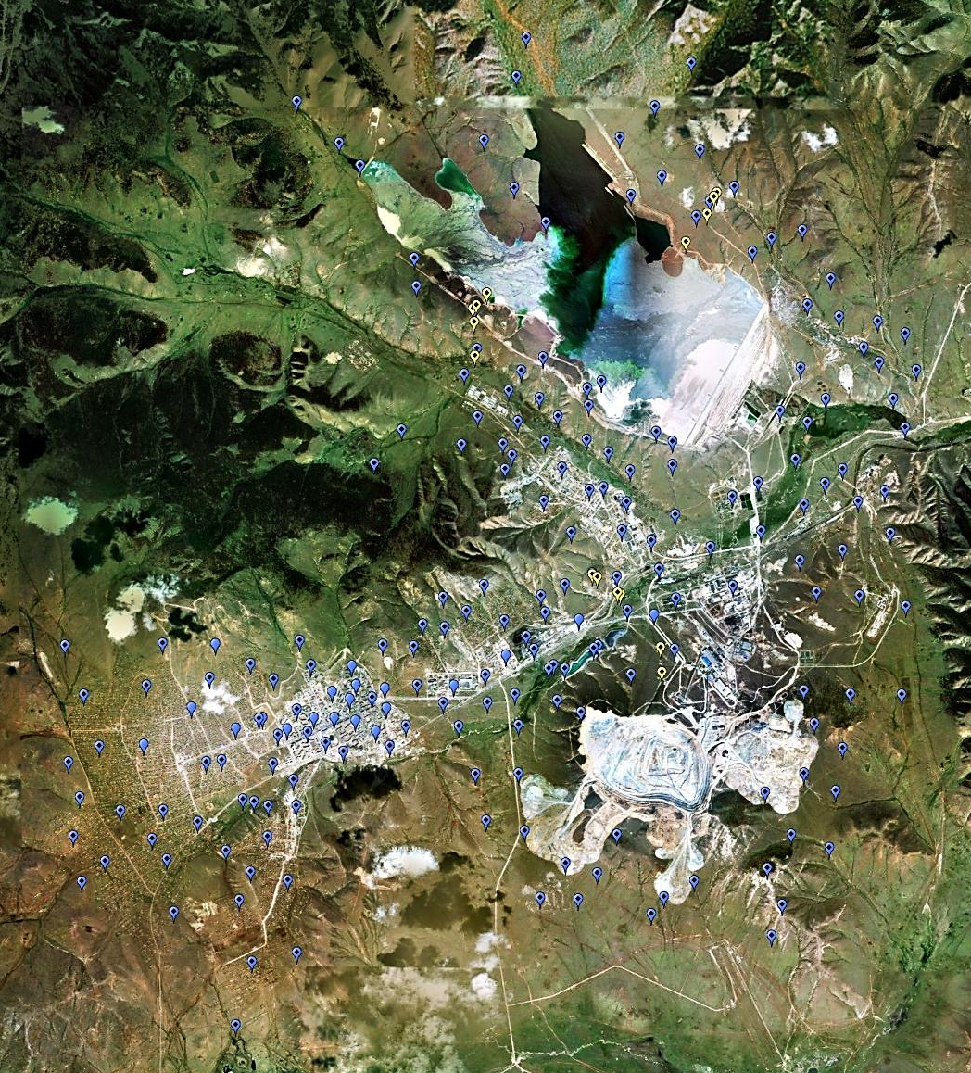
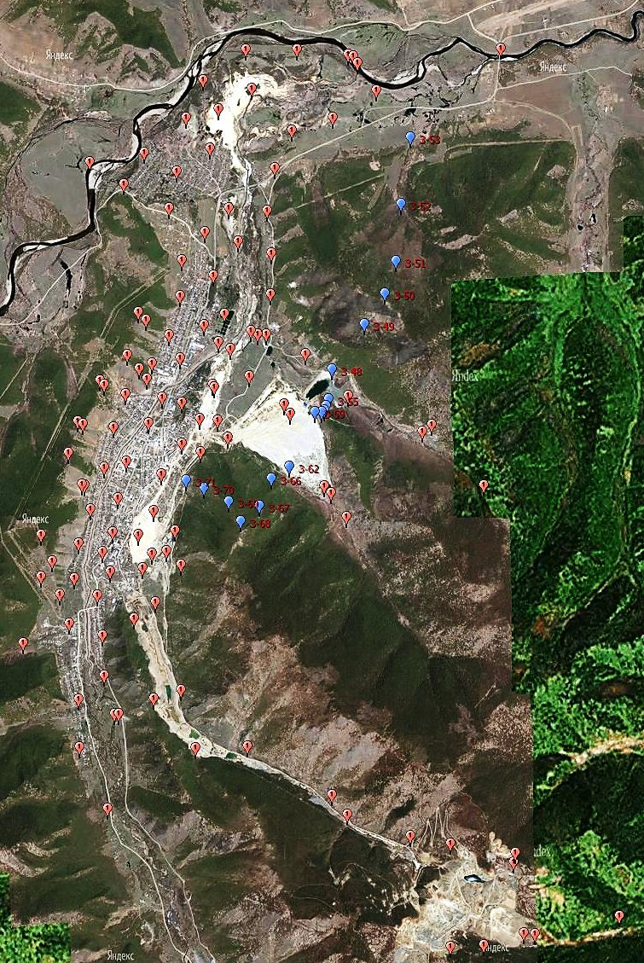
Location of Sampling Sites
Erdenet
Zakamensk
Zakamensk

Slide 6
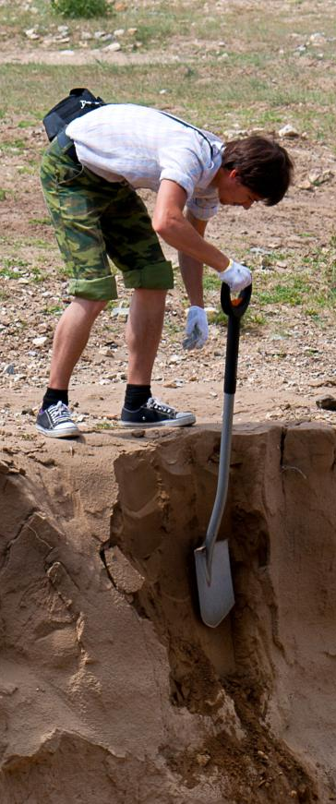
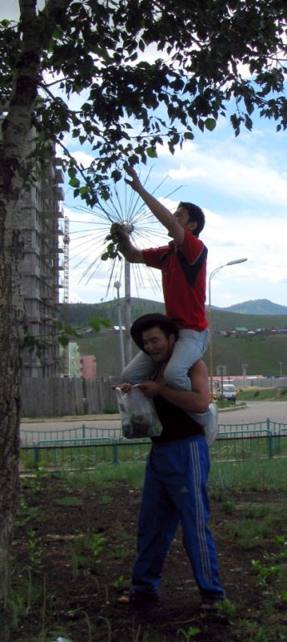
Total Sample Amount
Samples | Ulaanbaatar | Darkhan | Erdenet | Zakamensk | Zaamar
Topsoils | 90 | 125 | 270 | 119 | 86
Soil pits | 18 | 3 | 24 | 1 | -
Poplar leaves | 82 | 44 | 19 | 6 | -
Larch needles | 21 | - | 7 | 9 | -
Sediments | 5 | 2 | 10 | 11 | 11
Snow cover | 21 | 10 | 7 | - | -
Atmospheric aerosols | 132 | - | - | - | -
Brown coal, fly ash, sludge | 4 | 3 | 4 | - | -
Dumps, tailings | - | - | 24 | 16 | 43

Slide 7
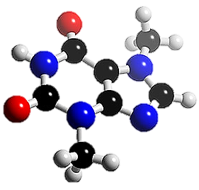
Analytical Works
Materials | Analysis
Atmospheric aerosols, dissolved and solid fractions of snow water, soils, poplar leaves, larch needles, brown coals, fly ash of TPP | Bulk content of chemical elements of different dangerous classes was determined using ICP-MS method: I (Be, Cr, Cd, Pb), II (Mn, Fe, Ni, Cu, As, Co), III (Zn, Mo, Sn, Sb, W, Bi), IV (V) unclassified elements (Ti, Sr, Th, U)[bvbz
Soils | Texture, pH, mineralization Content of organic carbon, CO₃²⁻, SO₄²⁻, Ca²⁺, Mg²⁺
Dissolved fraction of snow water | pH, mineralization, concentration of Al, Ca, Fe, K, Na, Mg, S, P

Slide 8
Data Processing Methods
Statistica 7.0 - statistical data processing
(mean, min-max, standard deviation, variability, cluster analysis)
Microsoft Excel - geochemical coefficients (CC/CD, Kc/Kd), geochemical spectra, integral pollution indexes (Zc, Zv), comparison with Maximum Allowable Concentrations standards
SPLUS - multivariate regression trees models for HM content in topsoils and vegetation
ArcGIS 10.0 - mapping
The analytical data were grouped according to functional zones to identify spatial geochemical heterogeneity of urban area depending upon their functional identity.

Slide 9
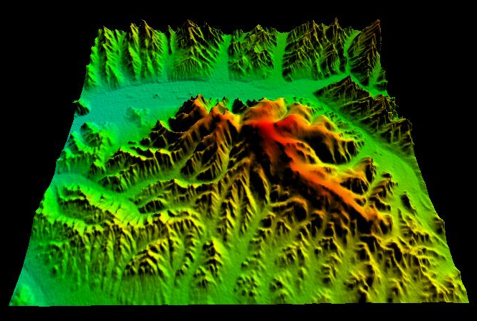

Study Area
Cities are situated in valleys of the Selenga tributaries;
Intermountain valley relief with elevations 700-1300 m above sea level;
Severely continental climate with annual precipitation from 360-400 mm in Zakamensk to 200-250 mm in Ulaanbaatar;
Parent material is represented with alluvial-prolluvial loamy sediments and sandy loams, shale rocks, granitoids and granosienits;
Ecotone zone of Southern Siberia and Central Asia:
- forests (often, typical sub-taiga) on mountain soddy taiga and mountain meadow-forest soils cover the Southern slopes,
- shrub-dry-steppes and meadow-steppes (gradually replaced by dry steppes) on mountain stony chernozems and chestnut soils cover the Northern slopes,
- meadow communities and willows (rarely poplar-Iarch riparian forests) on the alluvial stony-pebbly soils cover the river valleys.
Tuul Valley

Slide 10
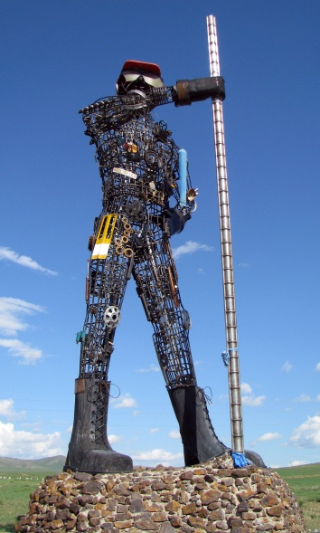
Anthropogenic Influence
Cities | Ulaanbaatar | Erdenet | Darhan | Zakamensk | Zaamar
Population, thousands pers | 1031 | 80,1 | 87,6 | 11,7 | 0,5
Traffic, thousands cars | 92,7 | 5,5 | 3,0 | <1,0 | -
Contamination sources | Multi-industry production | Cu-Mo ore mining and concentration | Ferrous metallurgy, dressing of leather, Au mining | W-Mo ore mining and concentration | Au mining
 | Traffic, thermal power plants and stoves in hoseholds in ger zones, fly ash of brown coal combustion
Environmental Backlash
land degradation due to wind and water erosion;
increasing of dust content in the atmosphere;
increasing of contamination of snow cover, vegetation and soils with technogenic substances, especially in cold season

Slide 11
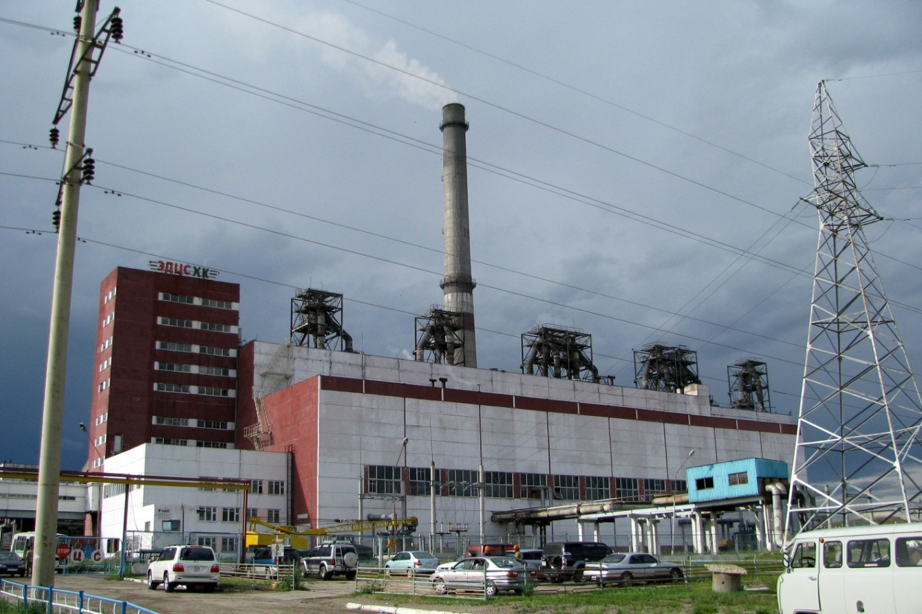
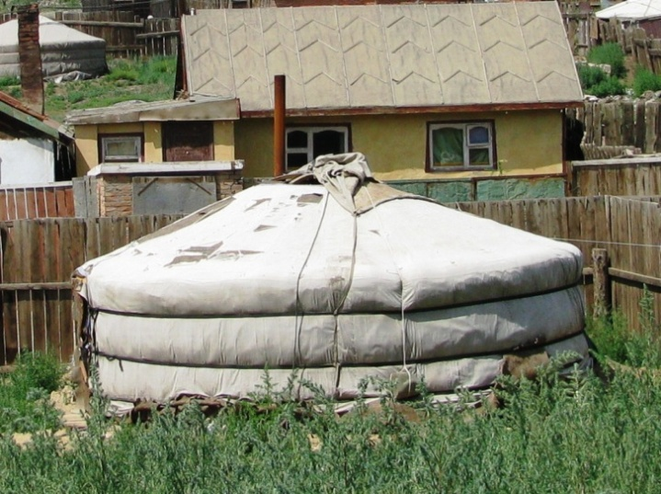
Geochemical Specialization
of Pollution Sources
Combustion
Sources
As, Bi, Zn, Th, Fe, Co, Cr, Cu
Be, Cd, Mo, Sb, Sr, V
300 m
3 m
TPP:
high
combustion
temperature
GER:
low
combustion
temperature

Slide 12
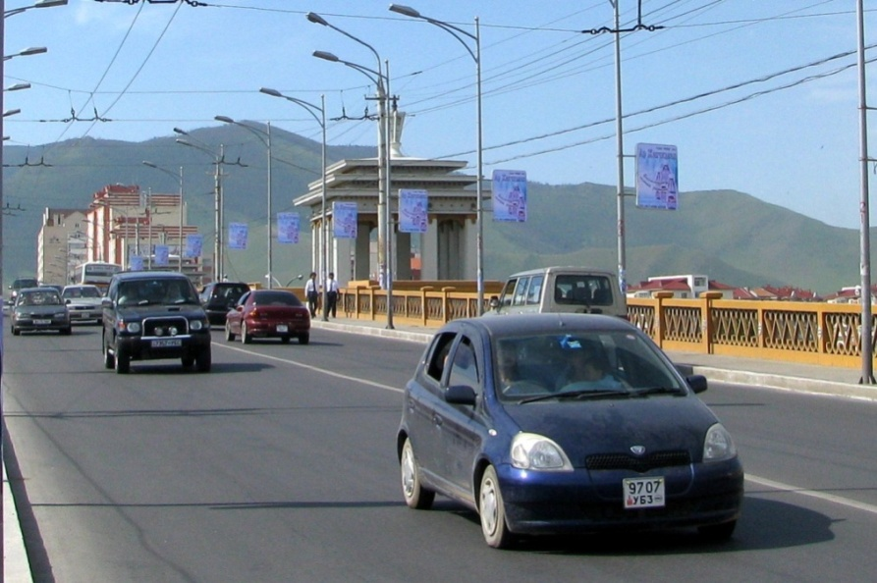
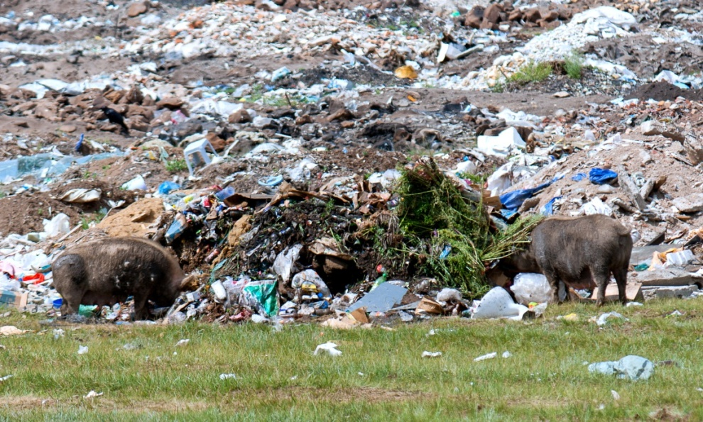
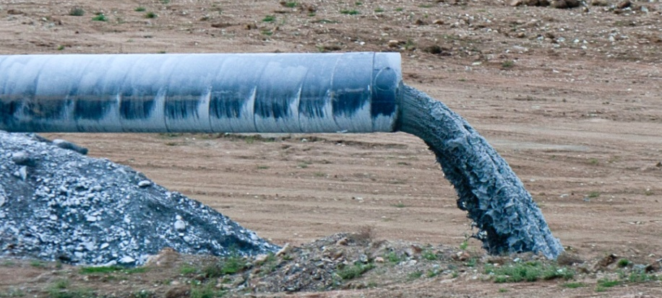
Geochemical Specialization
of Pollution Sources
Usual
Urban
Sources
Pb, Cd, Zn, Cu, Fe
wastes
leaded
petrol
Pb, Cd, Hg, Bi, Ag, Sn, Sb, Cu, Zn
Cd, Ag, Cu, Ni, Cr, Co, Zn, Pb, Mo, V, Sn, Sb, W
sewage

Slide 13
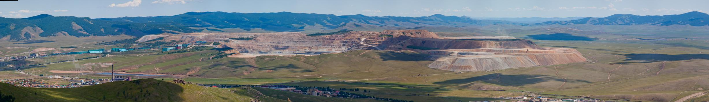
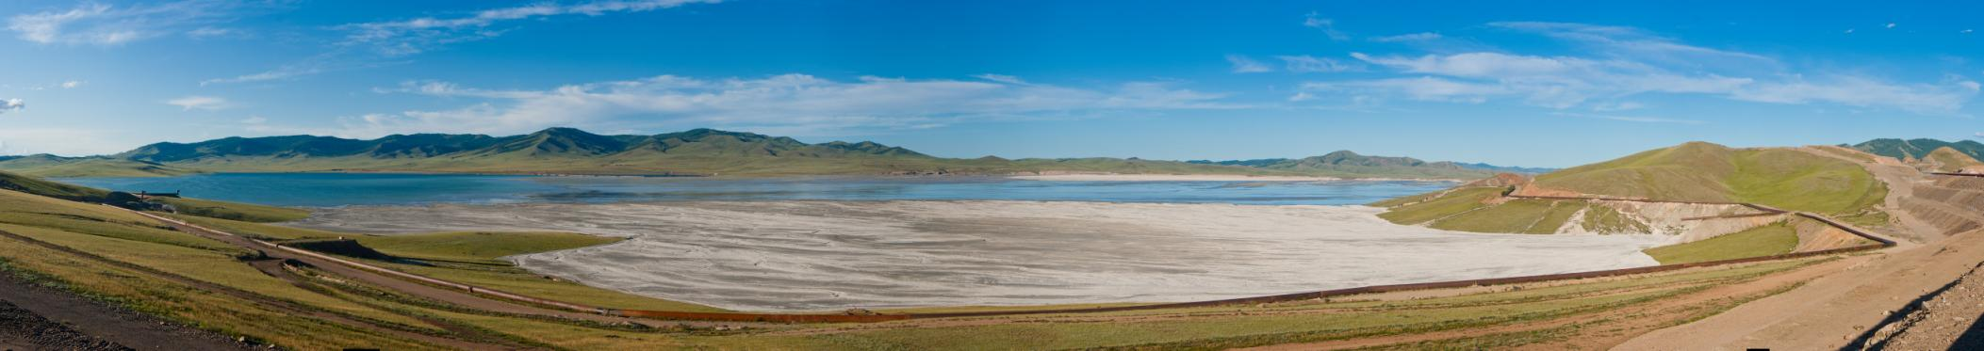
Geochemical Specialization
of Pollution Sources
Ore Mining and Extraction
Dumps
and
Tailings
Zn, Cu, Pb, Mo, W, Cd, Sb, F, As

Slide 14
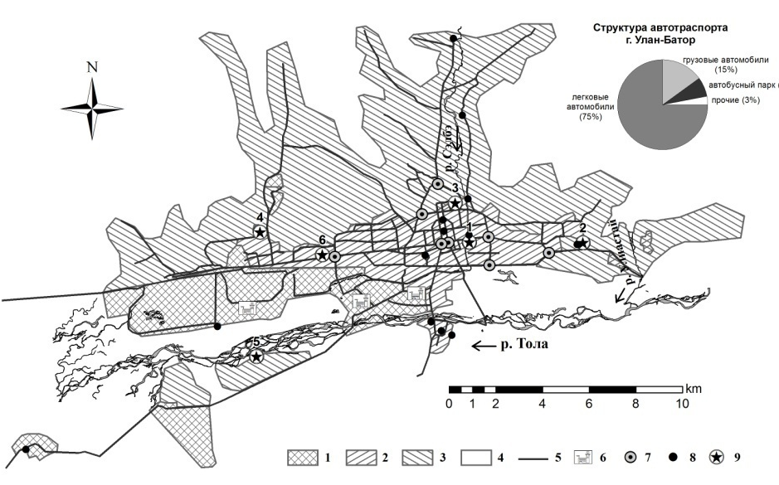
Ulaanbaatar: Air Pollution
Sampling sites
4
2
3
1
6
5
Atmospheric Pollution Index
60
Athmospheric
pollution
levels
50
40
30
very high
20
10
high
increased
0
low
DEC
JAN
FEB
MAR
center, multi-storied residential area (1)
center, ger residential area (4)
west, multi-storied residential area (2, 3)
south-west, ger residential area (5)
-
east, ger residential area (6)

Slide 15
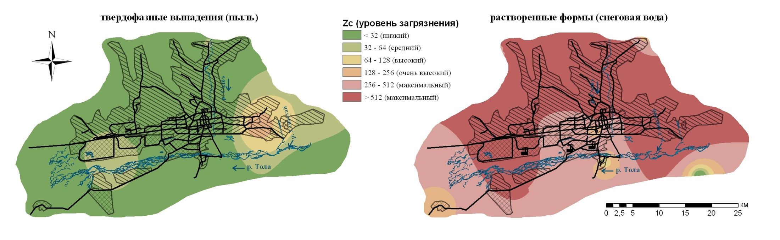
Ulaanbaatar: Pollution of Snow Cover
Solid Fraction (dust)
Integral Pollution Index Zc (pollution levels)
Dissolved Fraction (snow water)
< 32 (low)
32-64 (medium)
64-128 (high)
128-256 (very high)
256-512 (maximum)
> 512 (maximum)
Anomalies of Heavy Metals
Sr_{3,1}Mo_{3,0}Zn_{2,5}Ni_{2,4}Co_{2,2}V_{2,0}Cr_{2,0}Pb_{1,8}Cu_{1,7} Mo₁₂₁Ni₃₃Sr₃₀Co₁₄Zn_{4,5}V_{3,3}Pb_{3,1}Cu_{3,0}Cd_{2,7}Cr_{1,7}
Integral Pollution Indexes
Zc_{mean}=14,4 Zc_{mean}=239,6 - very high pollution level
Zc_{ger area} =23,3 Zc_{ger area}=431,0 - maximum pollution level
brown coal combustion result
low pollution level

Slide 16
Ulaanbaatar: Spatial Geochemical Heterogeneity of Urban Soils
Кс
6,0
Background soils geochemical specialization
As₅
5,0
4,0
3,0
2,0
1,0
Pb
Zn
Mo
Cr
Cu
Cd
Ni
Co
Sr
V
As
Functional Zones
Ulaanbaatar city
(Pb, Zn, Mo, Cr)
Industrial (Zn, Mo, Cr, Cd, Pb, Cu)
Traffic (Cr, Pb, Zn, Cu, Mo)
Multi-storied residential (Pb, Zn, Mo, Cd, Cu, Cr)
Ger residential (Pb, Zn)
Recreation (Mo, Ni)

Slide 17
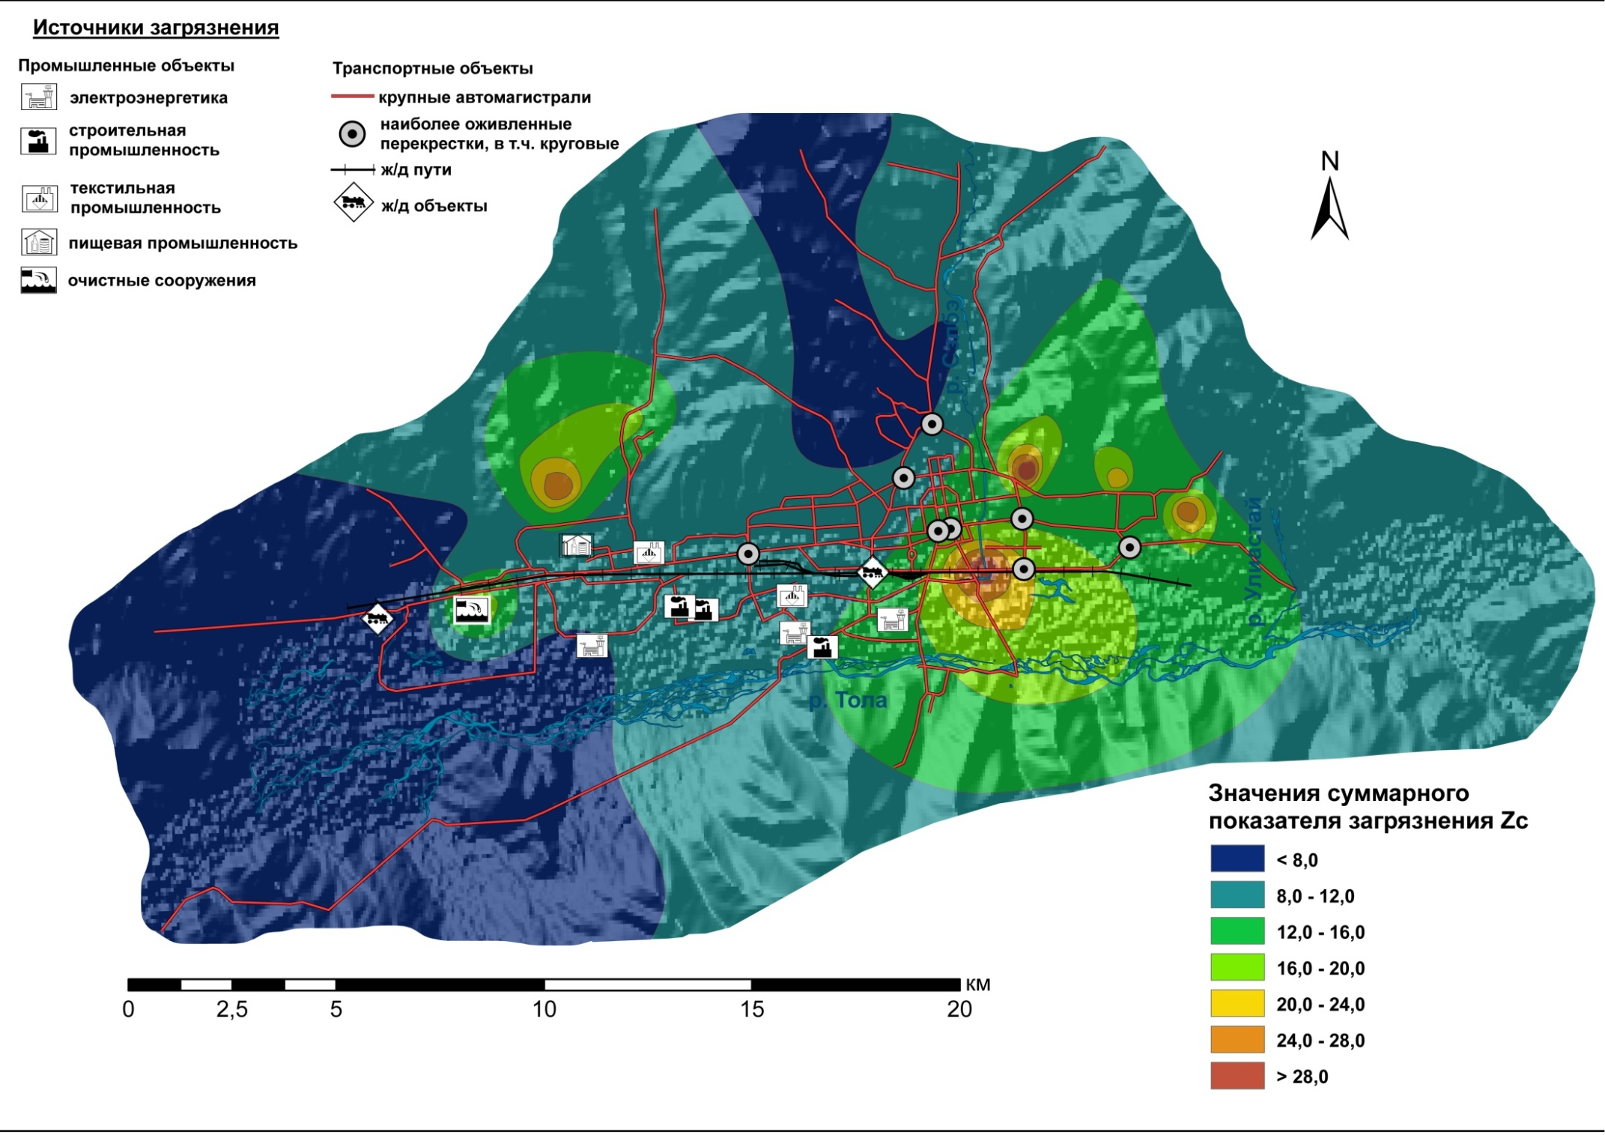
Ulaanbaatar: Pollution of Soils
POLLUTION SOURCES
Integral Pollution Index
Zc=ΣKc-(n-1)
n- number of samples with Kc>1,0
Industry
Traffic
Thermal power plants
Highways
Construction
Most busy intersections
Rail facilities
Textile
Railway objects
Food processing
Treatment plant
Integral Pollution Index Zc (pollution levels)
< 8 (low)
8-12 (low)
12-16 (low)
16-20 (medium)
20-24 (medium)
Excess of Maximum Allowable Concentration Standards
(% of city area) – As(100%)>Zn(38)>Mo(20)>Pb(18)>Cr(4)
24-28 (medium)
> 28 (medium)

Slide 18
Ulaanbaatar: the Influence of Landscape-Geochemical and Anthropogenic Factors on the Anomalies in Soils
Content of Organic Carbon
<0,7%
0,7-1,0%
>1,0%
Content of СO₃²⁻
Content of physical clay
Content of physical clay
<0,9%
>0,9%
<9,3
9,3-13,2%
>13,2%
<13%
>13%
2,8
Cv=56,7%
n=11
6,6
Cv=41,1%
n=10
6,1
Cv=19,5%
n=7
13,2
Cv=28,9%
n=6
Content of Organic Carbon
Content of СO₃²⁻
pH
<1,8%
>1,8%
<0,9%
>0,9%
<7,5
>7,5
5,9
Cv=36,3%
n=6
9,1
Cv=21,5%
n=7
10,0
Cv=51,1%
n=6
19,9
Cv=48,9%
n=10
Altitude
Content of СO₃²⁻
<1300 м
>1300 м
<1,1%
>1,1%
Heavy metals | Major accumulation factor
As, Cd, Cu, Mo, Zn | Content of organic carbon
Ni, Co | Content of physical clay
Pb, Sr | Content of SO₄²⁻
Cr | рН
V | Functional zone
16,6
Cv=57,5%
n=8
10,2
Cv=23,2%
n=6
6,7
Cv=50,9%
n=6
9,6
Cv=17,2%
n=10
Regression tree for integral pollution index (Zc) in the soils of Ulaanbaatar
The factors of the differentiation are given in the oval figures. The factor ranges are given on the lines. The figures with red shading present the following: the mean Zc value in the topsoils under particular combinations of factors; Cv - variation coefficient; n - number of samples.

Slide 19

Ulaanbaatar: Biogeochemical Specialization
Кс
Larch Needles
Кс
Poplar Leaves
9
9
7
7
5
5
3
3
As
Cr
Co
V
1
1
Mo
V
Pb
Cd
As
Co
Zn
Cu
Sr
Cr
Ni
Zn
Cd
Mo
Pb
Sr
Cu
Ni
3
3
5
5
7
7
9
9
Кр
Кр
Functional Zones
traffic
multi-storied residential
recreation
industrial
ger residential

Slide 20
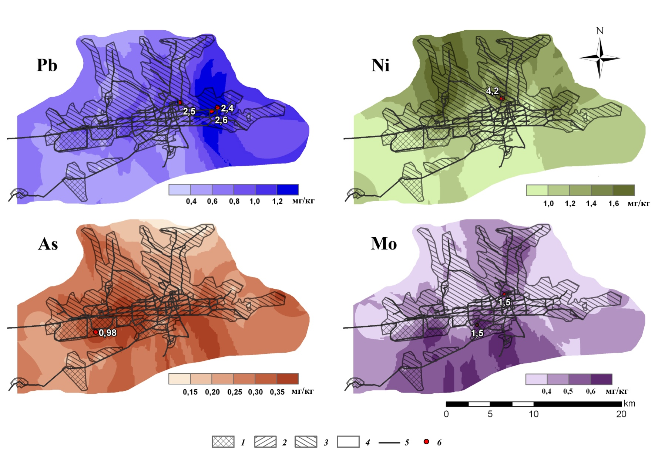
Ulaanbaatar: Distribution of Heavy Metals in the Poplar Leaves
mg/kg (ppm)
mg/kg (ppm)
mg/kg (ppm)
mg/kg (ppm)
Functional zones: 1 – industrial, 2 – multi-storied residential, 3 – ger residential,
4 – recreation; 5 – traffic; 6 – anomalies, mg/kg (ppm)

Slide 21
Ulaanbaatar: Environmental-Geochemical Assessment of Landscapes
Functional zones | Integral Pollution Indexes
 | Z_{c} of snow cover |  | Z_{c} of soils | Z_{v} of plants
 | dust | water |  | poplar leaves | larch needles
Industrial | 22 | 216 | 11 | 13 | 24
Traffic | - | - | 11 | 14 | 21
Residental, multy-storied | 3 | 89 | 16 | 13 | 23
Residental, ger | 23 | 431 | 9 | 13 | 17
Recreation | - | - | 7 | 8 | -
MEAN | 14 | 240 | 11 | 13 | 22

Slide 22
Darkhan: Spatial Geochemical Heterogeneity of Urban Soils
Кс
near Clark
concentrations
or lower
13
Background soils geochemical specialization
10
7
4
1
W
Cr
Hg
Ge
Mo
Zr
P
Zn
Ba
Ag
Y
Mn
Co
V
Cu
Ni
Ti
Pb
B
Sn
Li
Ga
Кd
Functional zones
Industrial
(W₁₅Cr_{8.8}Hg_{2.6}Ge_{1.9}Mo_{1.9}Zr_{1.5})
Multi-storied residential
(W_{8.6}Hg_{2.7}Ge_{1.5}Zn_{1.5})
Traffic
Ger residential
(W_{9.1}Zn_{1.8}Mo_{1.7}Hg_{1.5})

Slide 23
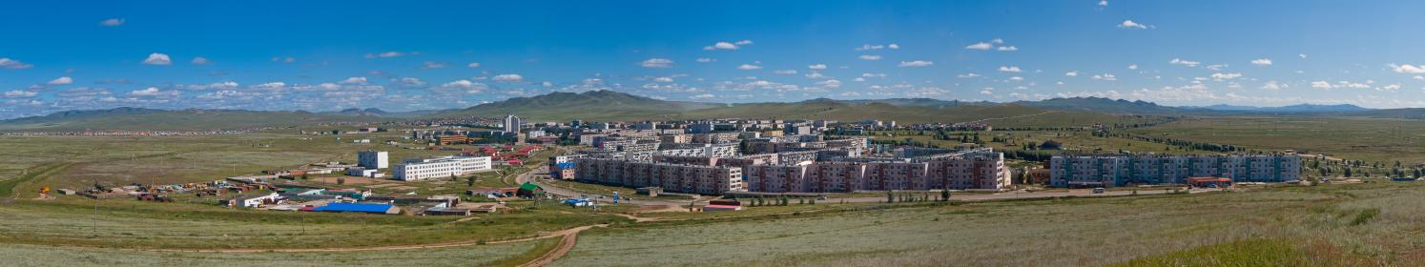
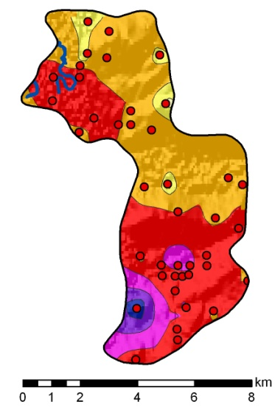
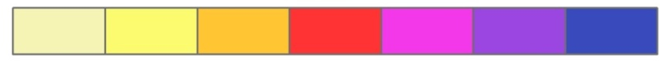
Darkhan: Pollution of Soils
Excess of Maximum Allowable Concentration Standards
(% of city area)
Cr(80%)>V(60)>Mo(49)>
Cu(27)>Zn(24)>Pb(13)
Pollution levels
Integral Pollution Index Zc
medium
very high
maximum
low
high
4
8
16
32
64
128

Slide 24
Erdenet: Spatial Geochemical Heterogeneity of Urban Soils
Кс
2
1
Sn
Ge
P
Zn
Cu
Mo
Pb
Ga
Co
Ni
Li
Cr
B
Zr
V
Ag
Ba
Ti
Mn
Hg
Y
W
2
3
Cu₈ Mo_{7.5}
Ag₄ Hg₃
Background soils geochemical specialization
4
5
Kd
Functional zones
Industrial
(Cu_{1.8}Mo_{1.5})
Multi-storied residential
(Ge_{2.2}Zn_{2.0} )
Traffic
Ger residential
(Sn_{2.6}Ge_{2.4}Zn_{1.7}Cu_{1.6}Mo_{1.5})

Slide 25
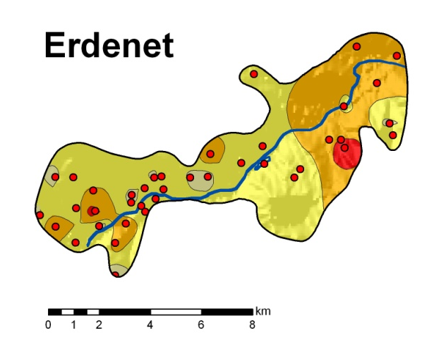
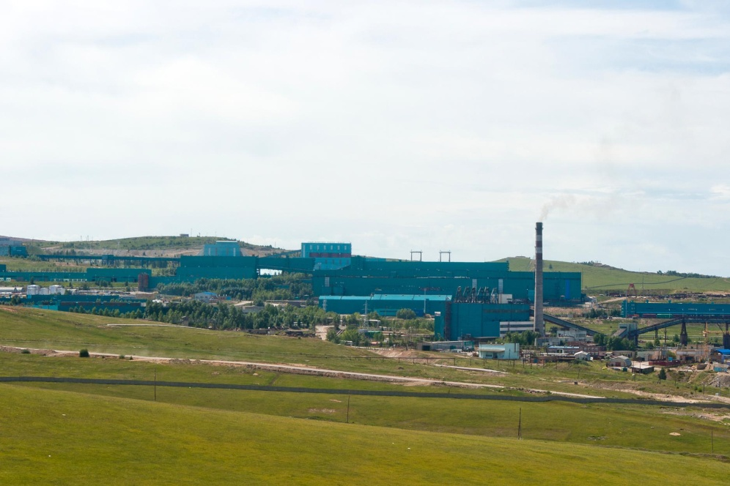
Erdenet:
Pollution of Soils
Excess of Maximum Allowable Concentration Standards
(% of city area)
Cu(82%)>Mo(71)>
Cr(51)>V(24)>Zn(20)
Pollution levels
Integral Pollution Index Zc
medium
very high
maximum
low
high
4
8
16
32
64
128

Slide 26
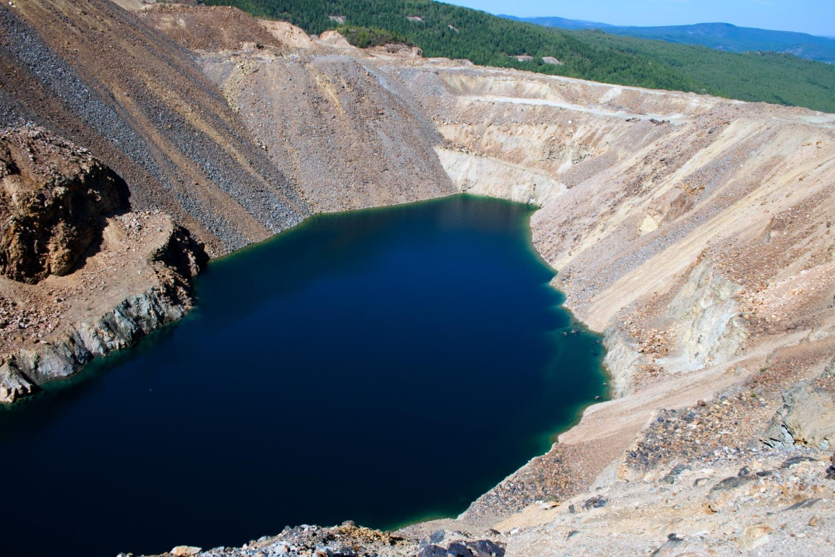
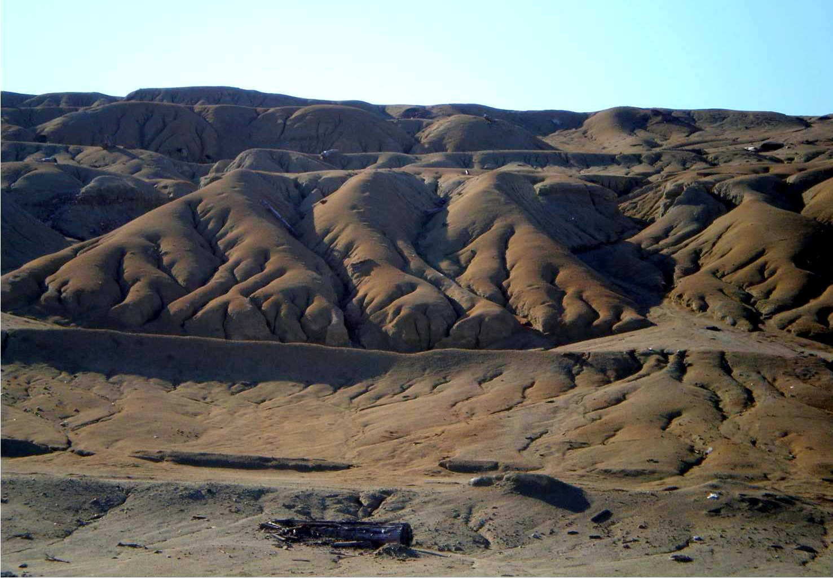
Zakamensk: Mining Industry
accumulation of waste products
44,5 million tones
Hydraulic
mine dumps
30 million tones
Tailings
9,5 million tones

Slide 27
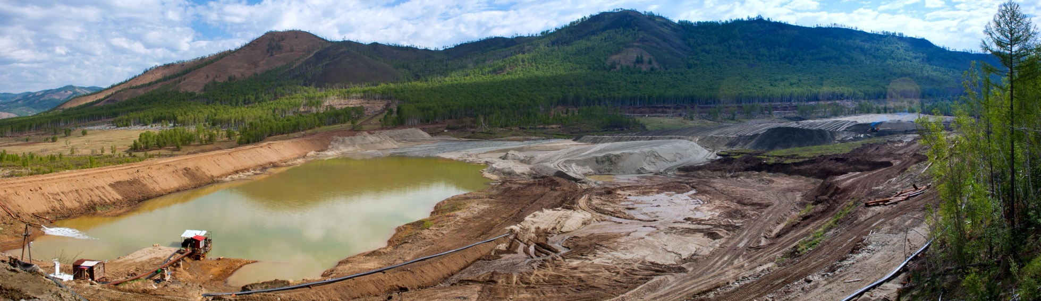
Zakamensk:
Accumulation of Heavy Metals in Soils*
 | U | Cu | Zn | As | Pb | Mo | W | Cd | Sb | F
Concentrations, mg/kg (ppm) | 9.7 | 23 - 830 | 70 – 1,000 | 3 – 50 | 15 – 870 | 1.3 – 260 | 20 - 1,100 | 0.5 – 14 | 2.6 – 120 | 50 - 16,000
Technogenic sands, Kc | 7 | 7.7 | 5.1 | 1.8 | 7.8 | 5.5 | 38.8 | 10.6 | 7.6 | 9.1
City center, park, Kc | 9 | 2.6 | 3.1 | 1.4 | 4.5 | 8 | 8 | 3.7 | 4.6 | 2.9
*Data were given by Fillipov Buryatiya State Agricultural Academy

Slide 28
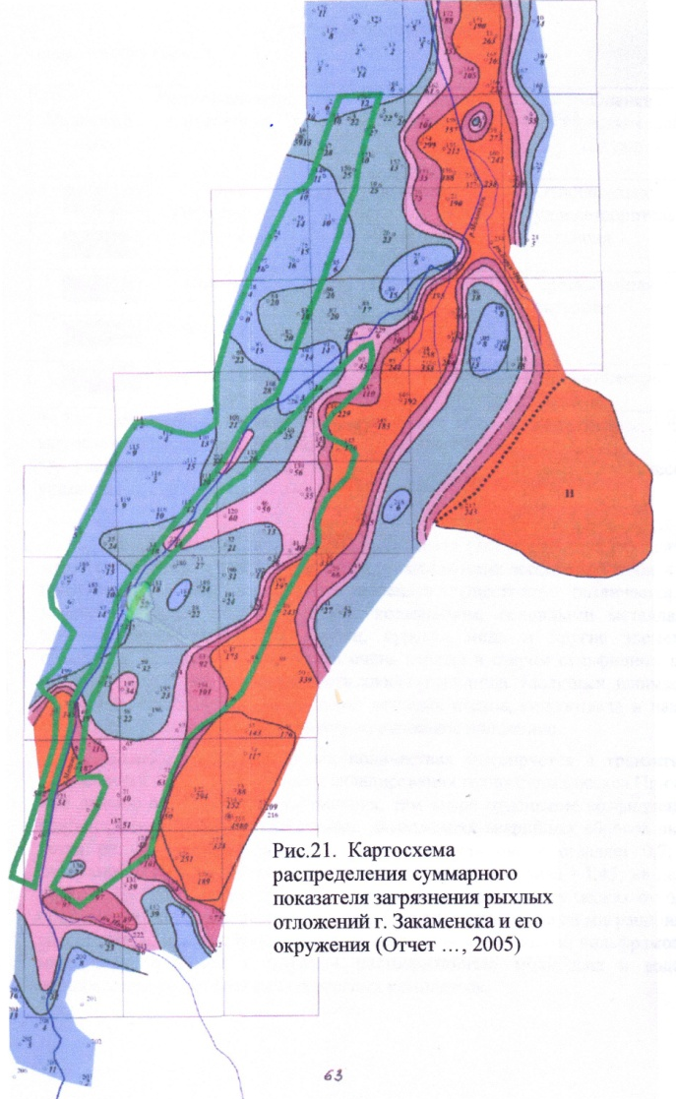
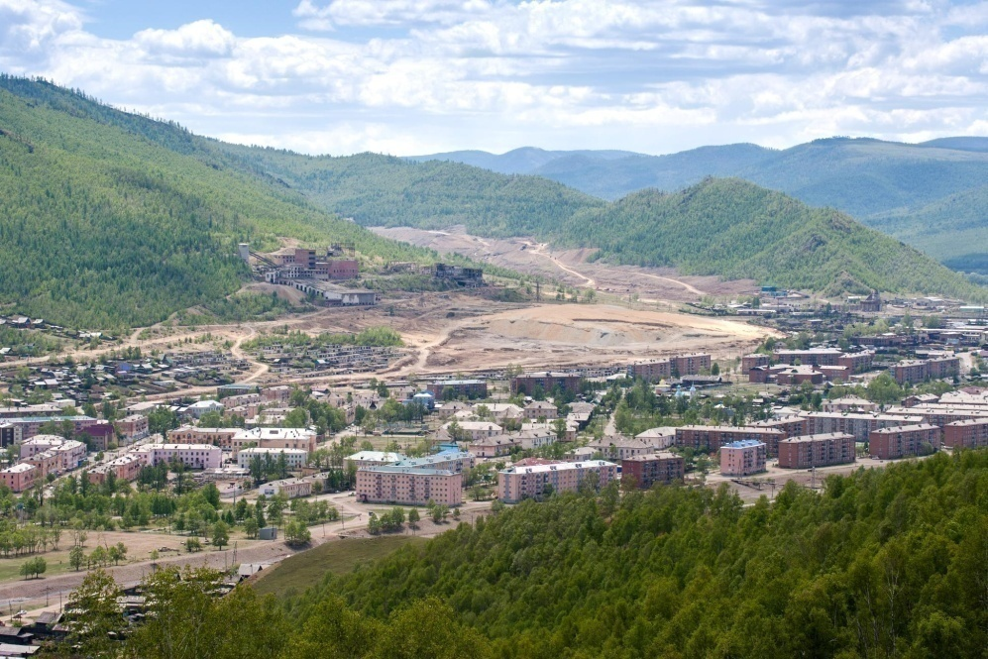
Zakamensk: Pollution of Soils*
Integral Pollution Index Zc
pollution levels)
< 16 (low)
16-32 (medium)
32-64 (high)
64-128 (very high)
> 128 (maximum)
*Data were given by Fillipov Buryatiya State Agricultural Academy

Slide 29
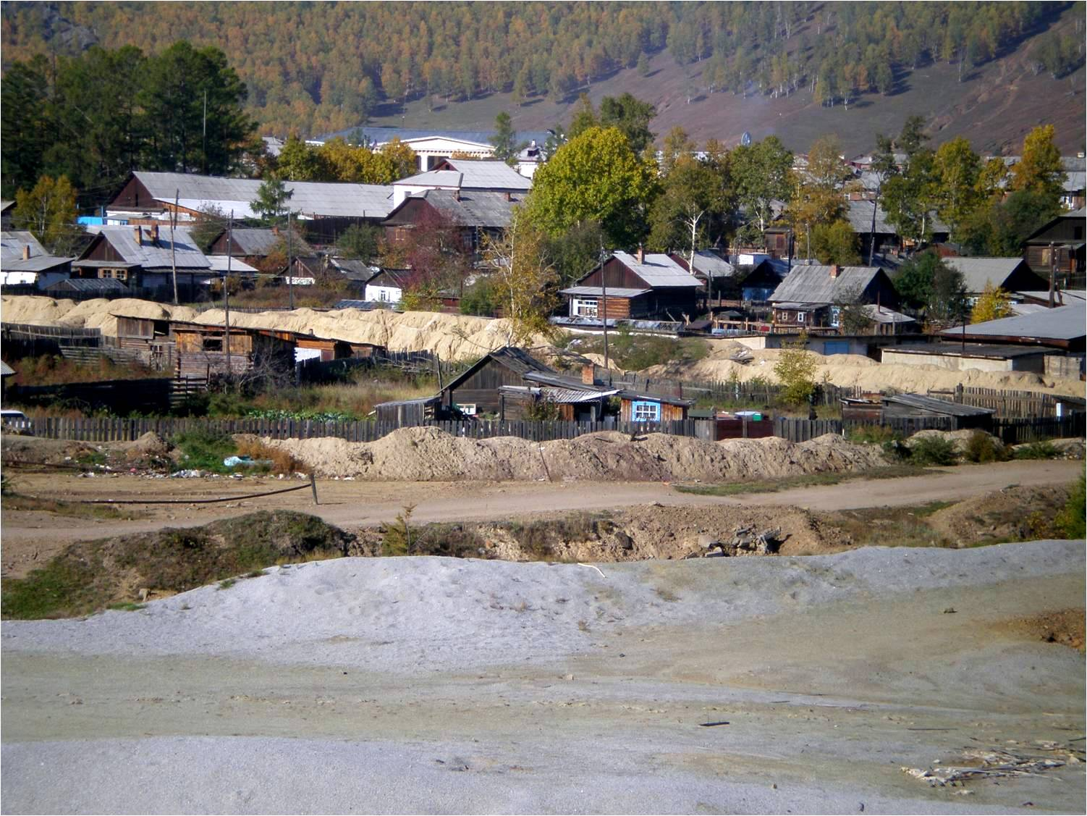
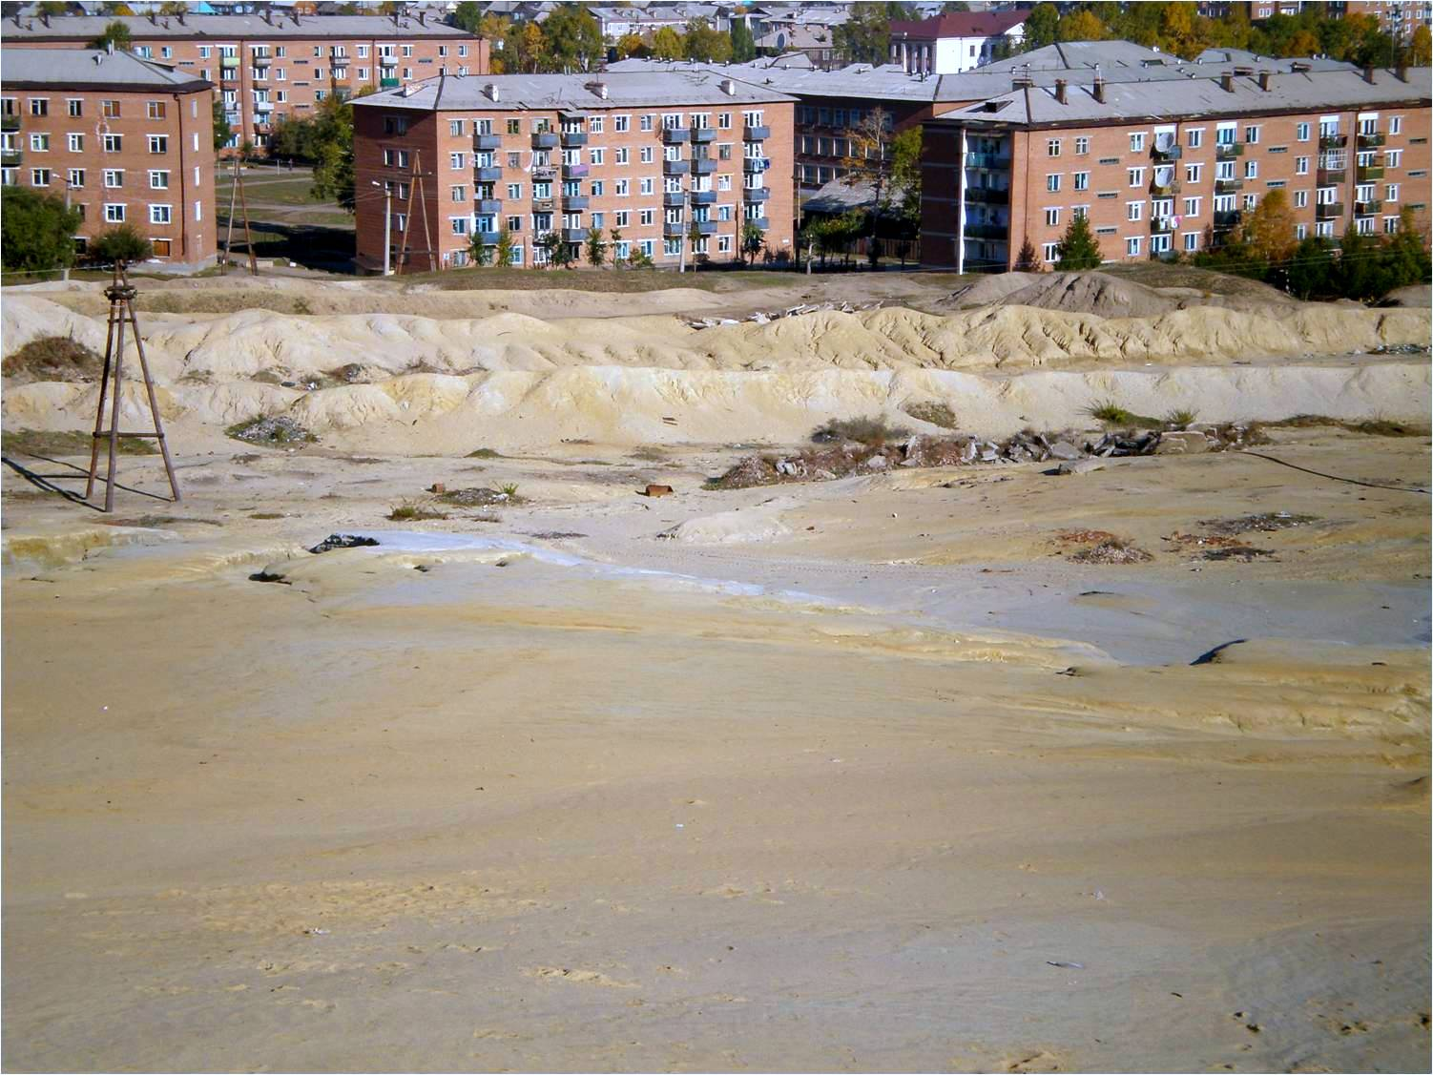
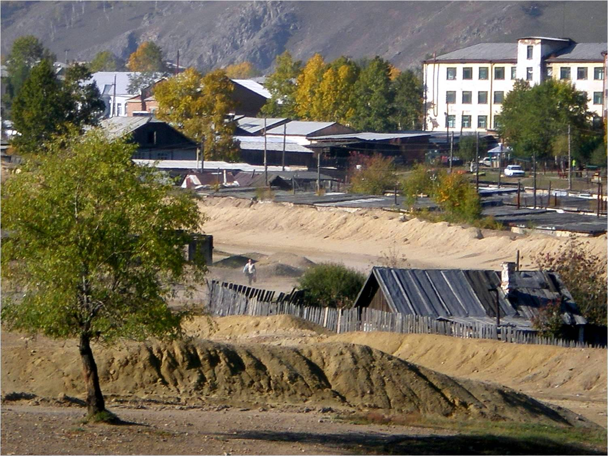
Zakamensk: Technogenic Sands in the Town
2011 – removal of
3.2 million tones of technogenic sands

Slide 30
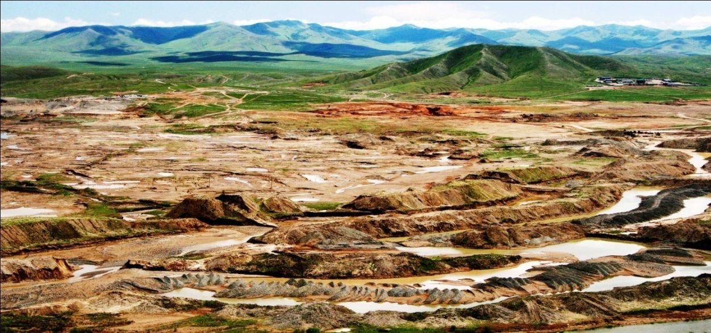
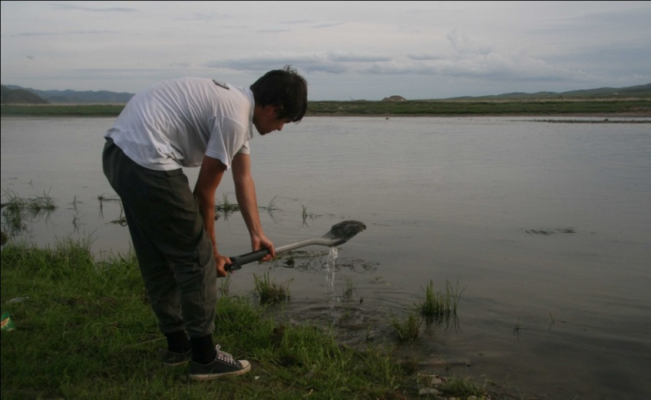
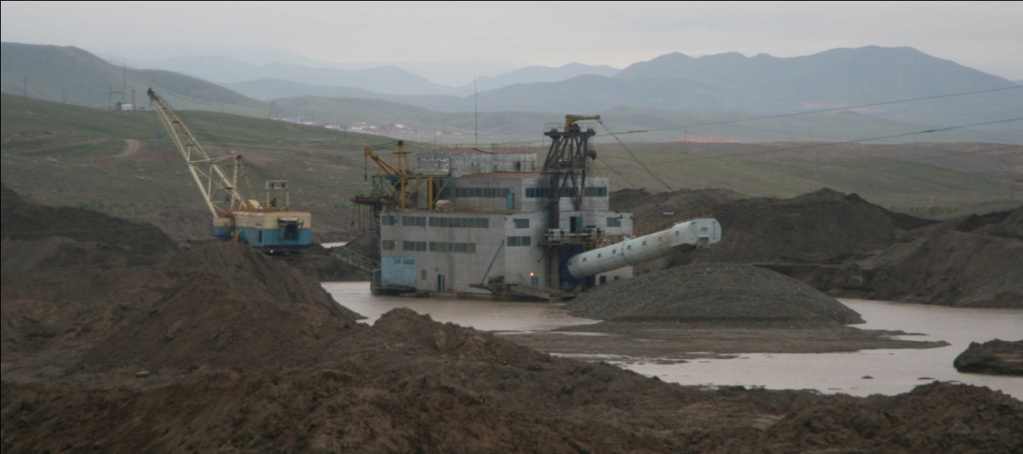
Zaamar area: Gold Mining
The Tuul river valley transformation
due to the gold mining
Sediments sampling from the Tuul river
Dredge working in the river valley

Slide 31
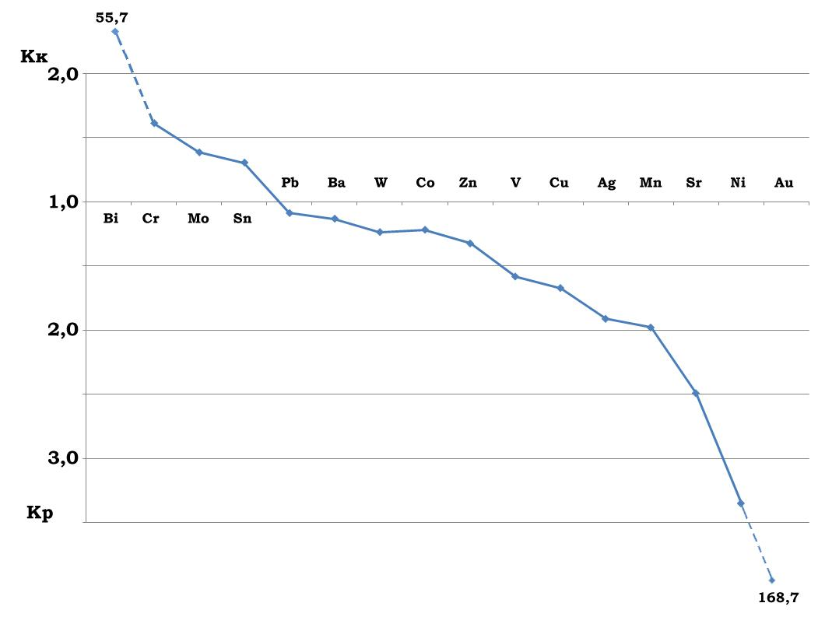
Zaamar area:
Geochemical Specialization of Soils

Slide 32
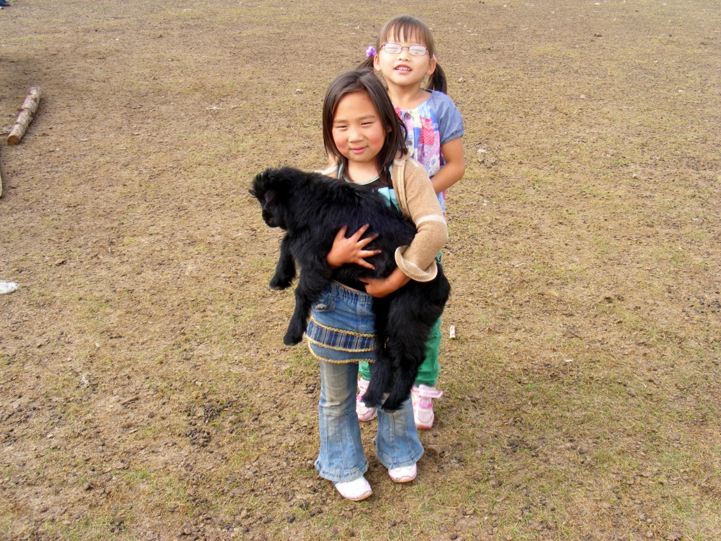
Thank You
for Your Attention!

